Slide 1
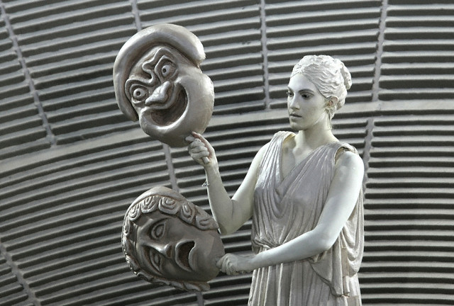
Ancient Greek Drama a.k.a – the theater of Ancient Greece
Mrs. Pace – Honors English I

Slide 2
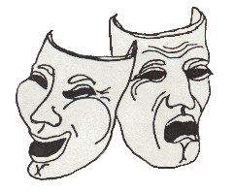
The theater flourished in Greece, particularly in Athens. Greek drama started at an annual festival called Dionysia, which honored the god Dionysus. This festival was held in late March.

Slide 3
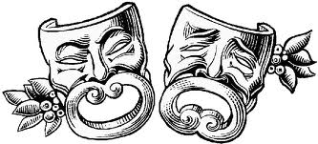
The Greek Theater/plays provided Greece with a way to promote a common cultural identity.
Dramatic performances were important to the Athenians. Plays were organized to foster loyalty among the various tribes around Athens.

Slide 4
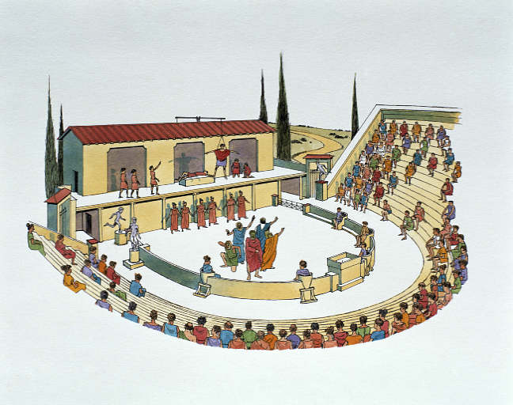
There were three types of plays made famous by the Greek Theater:
1. Comedy - The first comedies were mainly satirical and mocked men in power for their vanity and foolishness.
Slapstick
Crude humor
Usually concluded with a happy ending, characters finding pleasant resolution to original problem.

Slide 5
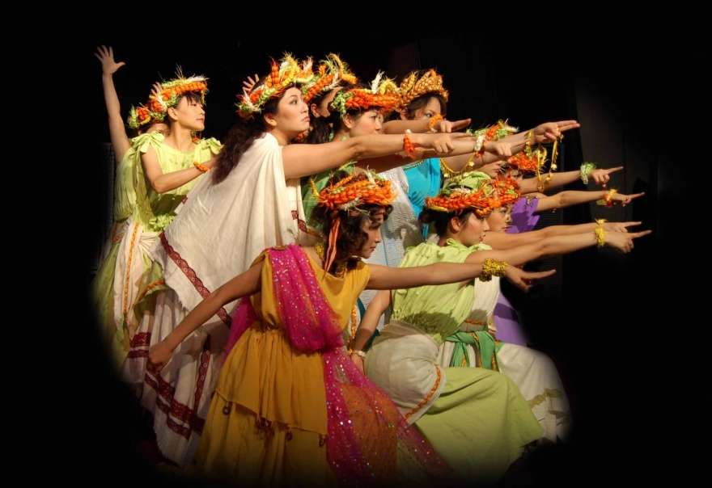
2. Tragedy - dealt with the big themes of love, loss, pride, the abuse of power and the fraught relationships between men and gods. Typically the main protagonist of a tragedy commits some terrible crime without realizing how foolish and arrogant he has been. Then, as he slowly realizes his error, the world crumbles around him.

Slide 6
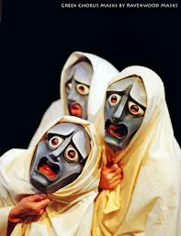
Tragedies have very specific conventions/rules:
Open with a prologue: a preliminary speech; gives background to the coming story
Followed by the parodos: the body of the story – usually occurred in three episodes.
The episodes are interspersed by stasimi – breaks in the story in which a chorus (group of actors) explains the situation developing in the scene.
Play ends with the exodus – which shows the wrapping up of the story.
**It’s important to note that MOST Greek tragedies followed this format, but not all playwrights strictly adhered to this structure.

Slide 7
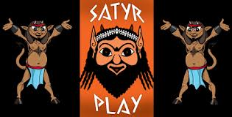
The satyr plays: were short plays performed between the acts of tragedies and made fun of the plight of the tragedy's characters.
The satyrs were mythical half human, half-goat figures . Actors in these plays wore large phalluses for comic effect. Few examples of these plays survive. They are classified by some authors as tragicomic, or comedy dramas – these types of plays might be the precursor to our modern romantic comedy.

Slide 8
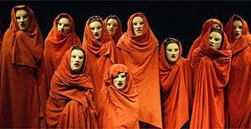
The ancient Greek plays were not just a show as we understand them today, but rather a ritual. The theaters (the building themselves) took on the role of sounding board for ideas, problems, and a place to question politics. The plays captured the deep rooted problems of the Athenian society.

Slide 9
Deep Thought:
Thinking about Antigone, and knowing that plays of this time were often written with the intent of drawing the public’s attention to a societal concern, what do you believe Sophocles was attempting to “show” the public?

Slide 10
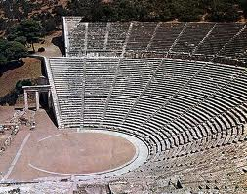
The End
Tomorrow we will talk more about the actual theaters/ampitheaters.

